Slide 1

STRENGTHENED EXPORT COMPETITIVENESS OF THE COUNTRY’S HORTICULTURAL PRODUCTS
Presentation Made by
Admire Jongwe, ZimTrade Client Manager
At The
Knowledge Sharing on Trade and Investment
“Good Practices II”
ACP House, Brussels, Belgium
4-5 February 2020

Slide 2

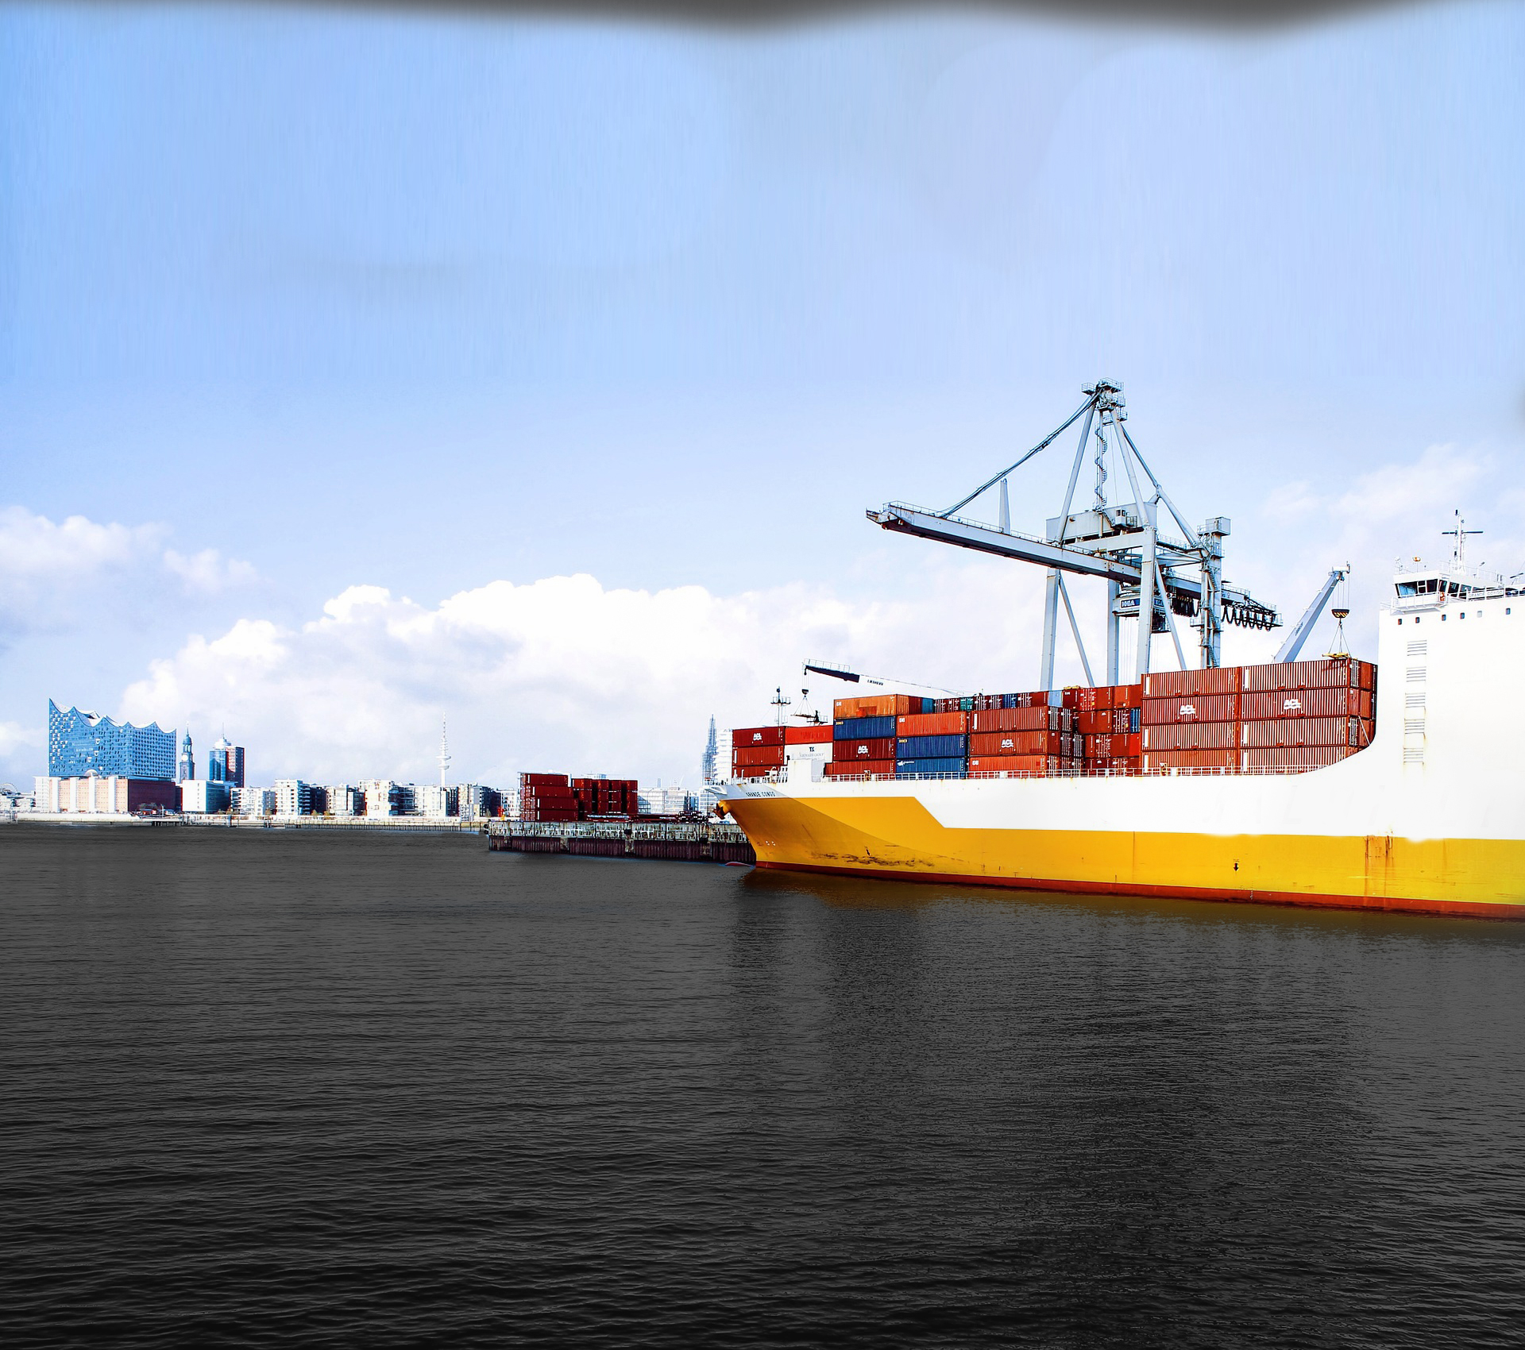
ZimTrade’s Mandate
ZimTrade is the National Trade Development and Promotion Organisation of Zimbabwe.
Our mandate is to energies Zimbabwe's Export growth

Slide 3





ZimTrade’s Service Portfolio
Export Development
Export Promotion
Market Intelligence
Advocacy
Notes:
Brochures

Slide 4
Zimbabwe Horticulture Background
Zimbabwe agrarian structure is dominated by SHF with limited connection to export markets.
New agrarian dispensation affected value chain compliance system and consequently reduced horticulture exports.
“low hanging” opportunity for Zimbabwe’s. In 2018 exports worth US$112 million were realised.
Targeting to attain US$200m in horticultural.
Horticultural export destinations are concentrated in EU, China and South Africa

Slide 5

Horticultural Competitiveness Challenges
1. Inadequate long and structured capital to support agriculture production
2. Inadequate infrastructure
3. Limited availability and high costs of agro-inputs
4. Turbulent macro-economic environment
5. Weak and low institutional support as well as intermittent enablers
6. Adverse weather patterns
7. Lack of security of land tenure/ land contestations

Slide 6





Horticultural Competitiveness Challenges
At the heart of challenges affecting Zimbabwe’s horticulture competitiveness is weak value chain compliance systems

Slide 7


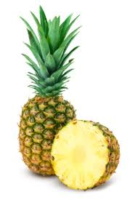
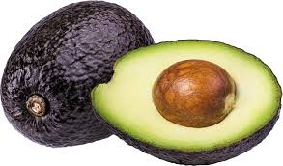
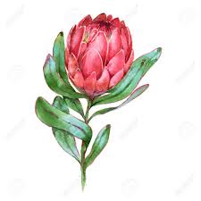

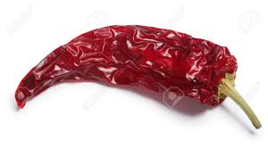
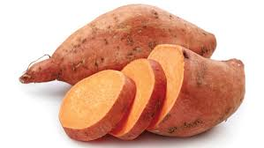

TradeCom II Project focus in Zimbabwe
Development of Stakeholder-led “Good Practice” Value Chain Compliance for Seven Selected Horticulture Products

Slide 8

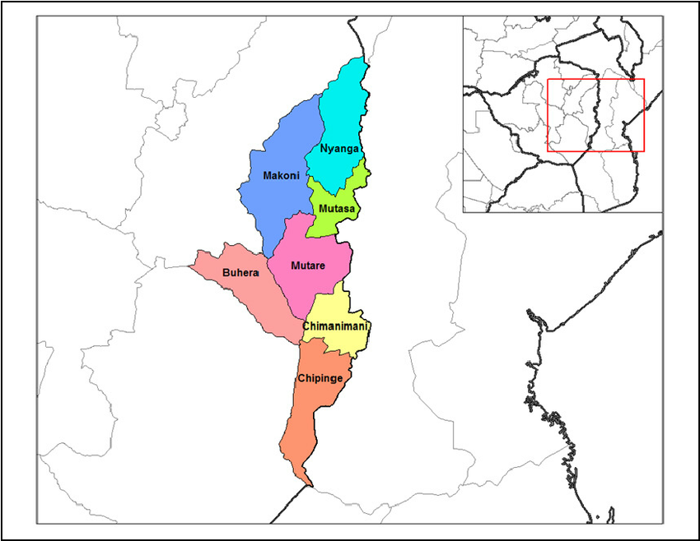
Areas Benefited from the Support

Slide 9

PROJECT OBJECTIVES and Results
Targeted support to strengthen the capacity and competitiveness of small-scale horticulture farmers for the production of niche export products under the interim EPA in Zimbabwe”,
Developed a stakeholder-led and “good practice” value chain compliance system for horticulture exports;
stakeholder-led & “good practice” VCCS; 7 Self-Assessment Guides
Improved the capacity of the beneficiaries to access value chain compliance and export requirements that enhance and sustain access to the EU
Export opportunity and requirements manual; Laboratory Report
Mainstreamed the recognized export requirements and “good practice” into the stakeholder-led value chain compliance system
7 Simplified and sector specific manuals for the implementation of respective stakeholder consultative processes

Slide 10

Project Focus
Knowledge sharing of export market requirements
EU Standards that Value chain operators
Mainstreaming standards
Ensuring that Horticulture exports are not returned
Developing a ‘good practice’ VCCS and national VC traceability mechanism
Supporting horticulture to be competitive

Slide 11

Good Practice Examples
1. Organic certification by the pineapple farmers
  -produce baby pineapples
  -market their products as a marketing trust
2. Social Coherence of the Mutema banana farmers
  -strong linkages with an off taker
  -good example of donor seed capital bearing fruit
3. Linkages between farmers and off taker in the floriculture sector
  -Off-taker in place consolidating product for export to the region and beyond.
4. Strong Hub in the Macadamia value chain
  -Consolidation for export market, supports farmers with inputs, technical knowhow, disease control, working capital.

Slide 12

Limitations of the Technical Assistance Support
Project proposed the NV compliance system
  Need to support
2. Project budget was never communicated
3. EU export Opportunities were identified
  Need to support
4. Findings were based on a sample and may not be representative.

Slide 13
Way-Forward
Investing in Global Compliance systems
  the “small steps” and discipline are essential for compliance
  mainstreaming Zim-GAP and IPM
  Piloting the NVCCS
  Organic certification for products
Invest in Product handling systems
Investment in cold chain facilities
Investment in export promotion

Slide 14

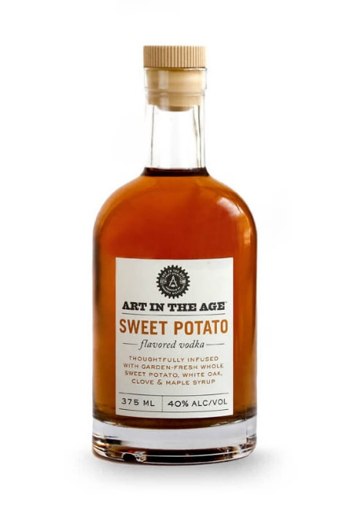





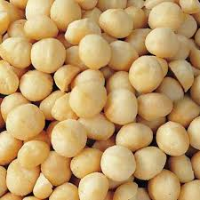
Way-Forward cont.
Value addition across the 7 VCs

Slide 15
Way-Forward cont.
Injection of new and varieties/planting material across the 7 VCs
Modernization and Accreditation of existing laboratories
Development and strengthen existing hubs to foster ownership and downstream connectivity

Slide 16





Assisting SHF. Metamorphosis of data into wisdom – trade intelligence
Intelligence into Wisdom
Knowledge into Intelligence
Information into Knowledge
Data into Information

Slide 17
Thank you!
Merci beaucoup !
Tatenda!
Siyabonga!

